Slide 1
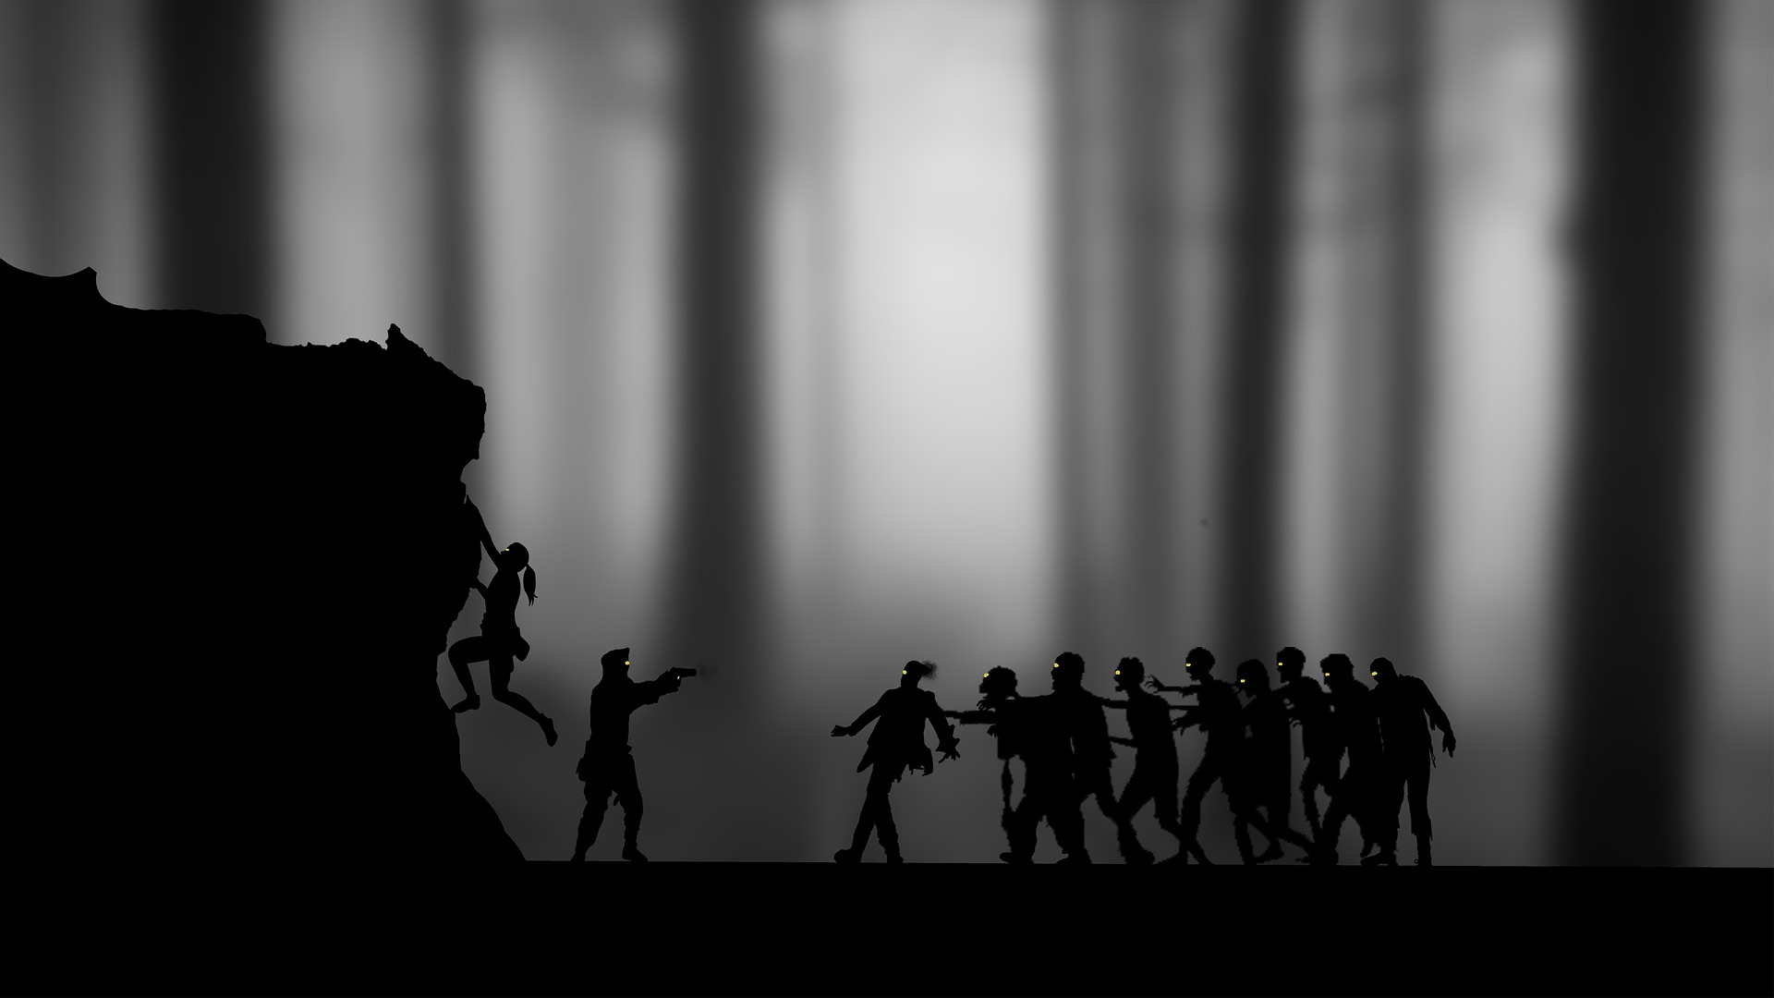
Zombie Outbreak
A discussion on the why and the what to do from here
Justin Butler

Slide 2
Warning
There are scenes and visuals depicted herein that are quite graphic.
The zombie outbreak has been gruesome and bloody. If you are sensitive
to this subject matter, please, feel free to step out for this presentation. I
wish to be true to the horror that has befallen humanity and will not shy
away from presenting it in an accurate manner.
Thank you for your understanding.

Slide 3
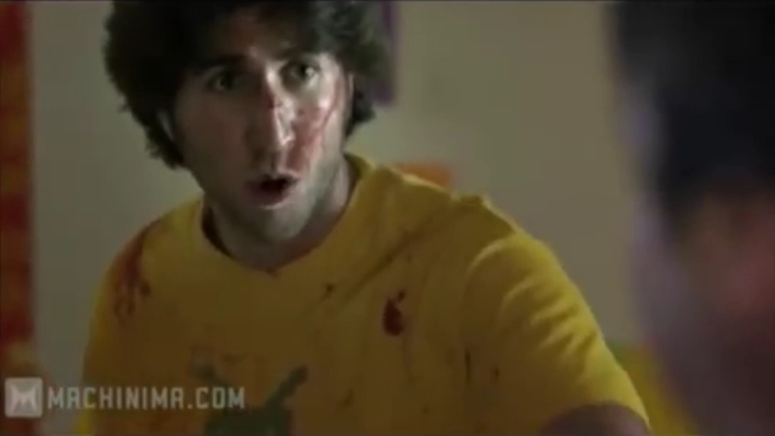
Rules of Zombies
YouTube. (July 4, 2013). “BITE ME: Full Season 1” Retrieved from https://www.youtube.com/watch?v=4Uo1-YLISgs

Slide 4
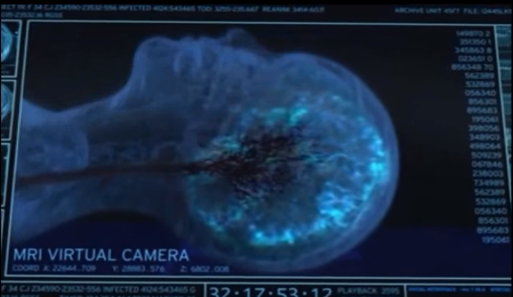
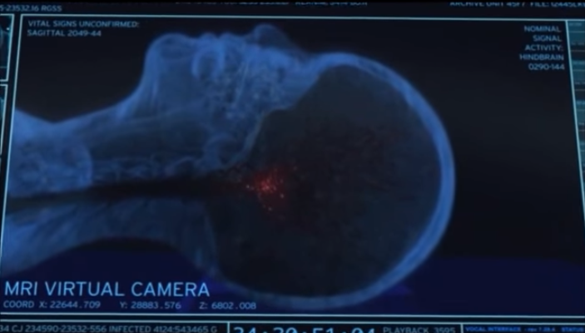
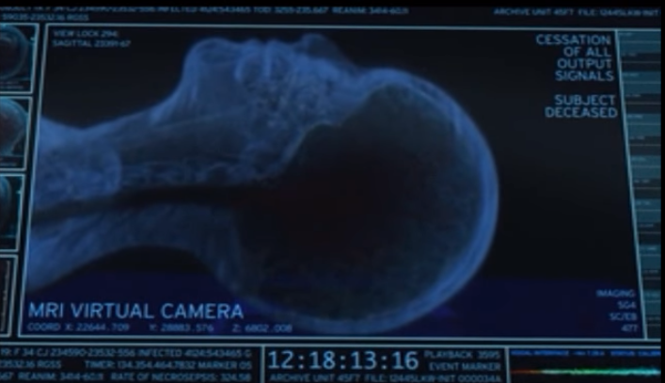
Preliminary Research: Test Subject 19
“TS-19.” The Walking Dead. Season 1, Episode 6. AMC. Aired December 6, 2010.

Slide 5
What kind of Zombies are there?
1. Voodoo
2. Romero
3. Type A
4. Cordyceps
5. Radioactive
6. T-Virus (or other)
7. Cybernetic
8. I am Legend (Wendigos)
Clues for determining which one we’re dealing with:
Organic and somewhat human-like
Slow gait and poor intellect
Post-mortem neural activity shift
Lack of radioactive tissue damage on corpses
Humans who die in other ways are not transformed

Slide 6












Modeling the Outbreak
Population of Survivors
Scratch Work
Rate of Change for Survivors
Zombie-Human Interaction (Zombie Wins)
$$S$$
Zombie-Human Interaction (Human Wins)
$$S$$
$$S$$
$$S$$
Birth of New Humans
$$\frac{dS}{dt}=$$
$$−βSZ$$
$$πS$$
$$αSZ$$
$$βSZ$$
$$βSZ$$
Population of Zombies
Rate of Change for Zombies
$$Z$$
Death of Humans by non-zombie causes
$$Z$$
$$\frac{dZ}{dt}=$$
$$−αSZ$$
$$−δS$$

Slide 7











How to Solve these equations
$$S(t)$$
$$t$$
$$1$$
$$2$$
$$3$$
$$4$$
$$5$$
$$6$$
$$7$$
$$8$$
$$9$$

Slide 8
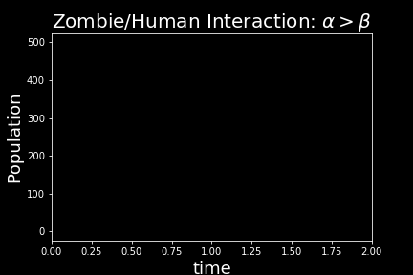
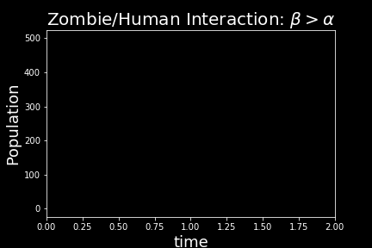
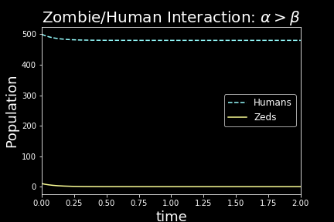
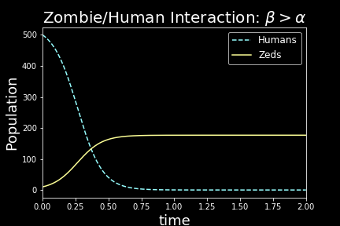






Possible Outcomes:
$$\frac{dS}{dt}=πS−βSZ−δS$$
$$\frac{dZ}{dt}=βSZ−αSZ$$
Humans: 500 vs. Zombies: 10
$$α=0.06$$
$$β=0.04$$
$$β=0.06$$
$$α=0.04$$

Slide 9
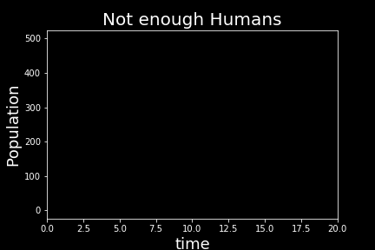
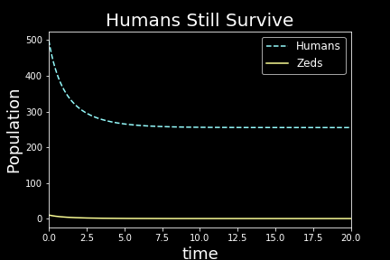
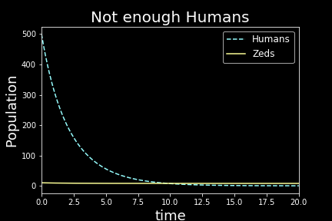







More Possibilities
$$\frac{dS}{dt}=πS−βSZ−δS$$
Humans: 500 vs. Zombies: 10
$$\frac{dZ}{dt}=βSZ−αSZ$$
$$α=0.051$$
$$β=0.049$$
$$α=0.0501$$
$$β=0.0499$$

Slide 10



Other Research Possibility
$$\frac{dS}{dt}=πS−βSZ−δS$$
$$\frac{dZ}{dt}=βSZ−\left[α\left(1−\frac{1}{t}\right)\right]SZ$$
Notice $\left(1−\frac{1}{t}\right)$ will approach 1. Thus, if $α$ is much larger than $β$ (as it should be), the skill of humans will surpass those of the zombies over time.

Slide 11
Thank you
References:
Wikipedia Contributors. “Types of Zombies.” November 15, 2017. Accessed November 25, 2017 at http://zombie.wikia.com/wiki/Types_of_Zombies
YouTube. (July 4, 2013). “BITE ME: Full Season 1” Retrieved from https://www.youtube.com/watch?v=4Uo1-YLISgs
The Walking Dead. AMC.
Linhart, Jean. “Zombies.” Fall 2017. Central Washington University.

